Slide 1

The Evolution of Artificial Intelligence: A Journey Through History
Understanding the Advancements of AI Development
By: Me

Slide 2
Introduction to AI What is AI?
Definition: Simulation of human intelligence by computer systems.
Subfields: Machine Learning, Natural Language Processing, Robotics.

Slide 3
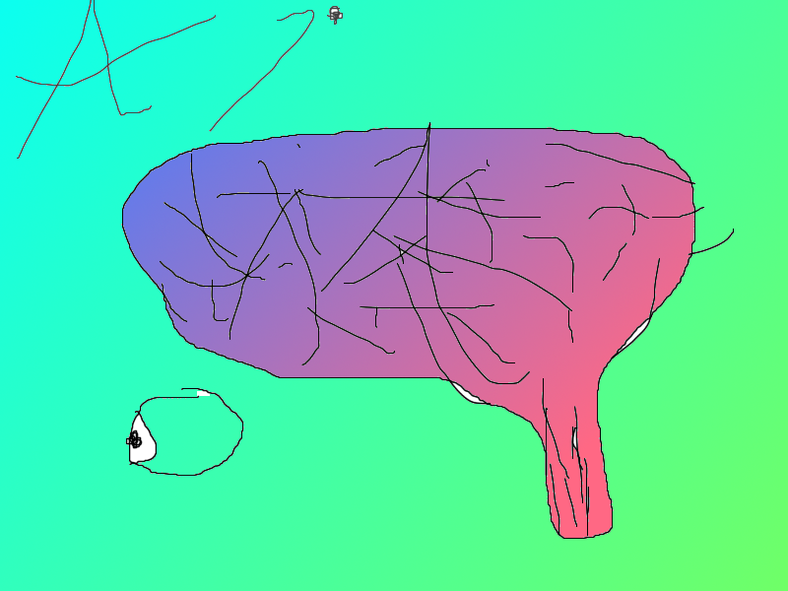
Early Beginnings (1950s-1960s)
Key Developments:
1950: Alan Turing proposes the Turing Test.
1956: Dartmouth Conference solidifies AI as a field.
Notable Figures:
John McCarthy, Marvin Minsky, Herbert Simon.

Slide 4

The First AI Programs (1960s-1970s)
Symbolic AI:
Development of early programs like ELIZA (a chatbot) and SHRDLU (natural language processing).
Limitations:
Lack of computational power and understanding of complex algorithms.

Slide 5
The AI Winters (1970s-1990s)
Challenges Faced:
Disappointment in AI's capabilities led to funding cuts.
Two significant downturns known as "AI Winters.“
Consequences:
Many researchers left the field, and interest waned.

Slide 6

The Resurgence of AI (1990s-2000s)
Revival Factors:
Increased computational power (CPUs and GPUs).
Data availability increased, supporting machine learning.
Milestones:
IBM’s Deep Blue defeats chess champion Garry Kasparov (1997).

Slide 7
The Era of Machine Learning (2000s-2010s)
Advancements in Techniques:
Evolution of algorithms: decision trees, neural networks, and deep learning.
Key Developments:
Google’s use of machine learning for search algorithms.
Emergence of AI frameworks like TensorFlow and PyTorch.

Slide 8
Breakthroughs in Deep Learning (2010s)
Revolutionary Progress:
2012: AlexNet wins the ImageNet competition, boosting interest in deep learning.
Natural language processing (NLP) advancements with models like GPT and BERT.
Applications:
Image recognition, speech recognition, and language translation.

Slide 9

AI in Everyday Life (2020s)
Ubiquity of AI:
Smart assistants (Siri, Alexa), personalization (Netflix, Spotify).
AI in healthcare for diagnostics and predictive analytics.
Ethics and Concerns:
Bias in algorithms and AI transparency challenges.
Mona Lisa

Slide 10
The Future of AI
Potential Advancements:
General AI: Moving beyond narrow AI to more generalized applications.
Autonomous systems: Advancements in self-driving cars and drones.
Global Impact:
Economic implications and changes to the job market.

Slide 11
Conclusion
Summary of AI Evolution:
From conceptual beginnings to everyday applications.
Ongoing challenges and ethical considerations.
Final Thoughts:
The necessity for responsible AI development and governance.

Slide 12
Thank you for your attention.
ALL Images WERE made by the author of the Presentation
ALL TEXTUAL CONTENT WERE made by Copilot’s AI

